Slide 1
Minimum Spanning Trees

Slide 2
Minimum Spanning Trees
Spanning subgraph
Subgraph of a graph G containing all the vertices of G
Spanning tree
Spanning subgraph that is itself a (free) tree
Minimum spanning tree (MST)
Spanning tree of a weighted graph with minimum total edge weight
Applications
Communications networks
Transportation networks
ORD
10
1
PIT
DEN
6
7
9
3
DCA
4
STL
8
5
2
DFW
ATL

Slide 3
Cycle Property
Cycle Property:
Let T be a minimum spanning tree of a weighted graph G
Let e be an edge of G that is not in T and C let be the cycle formed by e with T
For every edge f of C, weight(f) ≤ weight(e)
Proof:
By contradiction
If weight(f) > weight(e) we can get a spanning tree of smaller weight by replacing e with f
f
8
4
C
9
2
6
3
e
8
7
7
Replacing f with e yields a better spanning tree
f
8
4
C
9
2
6
3
e
8
7
7

Slide 4
Partition Property
Partition Property:
Consider a partition of the vertices of G into subsets U and V
Let e be an edge of minimum weight across the partition
There is a minimum spanning tree of G containing edge e
Proof:
Let T be an MST of G
If T does not contain e, consider the cycle C formed by e with T and let f be an edge of C across the partition
By the cycle property, weight(f) ≤ weight(e)
Thus, weight(f) = weight(e)
We obtain another MST by replacing f with e
U
V
f
7
4
9
2
5
8
8
e
3
7
Replacing f with e yields another MST
U
V
f
7
4
9
2
5
8
8
e
3
7

Slide 5
Kruskal’s Algorithm

Slide 6
Kruskal’s Algorithm: Example
G
G
B
8
8
4
B
4
9
E
6
9
E
6
1
5
F
1
5
F
C
11
3
C
11
3
2
2
7
D
H
7
H
A
D
10
A
10
G
G
B
8
B
8
4
4
9
E
6
9
E
6
1
5
F
1
5
F
C
11
3
C
11
3
2
2
7
D
H
7
H
D
A
10
A
10

Slide 7
Example (contd.)
G
G
B
8
8
4
B
4
9
E
6
9
E
6
1
5
F
1
5
F
C
11
3
C
11
3
2
2
7
D
H
7
H
D
A
10
A
10
four steps
two steps
G
G
B
8
B
8
4
4
9
E
6
9
E
6
1
5
F
1
5
F
C
11
3
C
11
3
2
2
7
D
H
7
D
H
A
10
A
10

Slide 8
Kruskal’s Algorithm
Maintain a partition of the vertices into clusters
Initially, single-vertex clusters
Keep an MST for each cluster
Merge “closest” clusters and their MSTs
A priority queue stores the edges outside clusters
Key: weight
Element: edge
At the end of the algorithm
One cluster and one MST (if connected)
Algorithm KruskalMST(G)
for each vertex v in G do
Create a cluster consisting of v
let Q be a priority queue.
Insert all edges into Q
T ← ∅
{T is the union of the MSTs of the clusters}
while T has fewer than n − 1 edges do e ← Q.removeMin().getValue()
[u, v] ← G.endVertices(e)
A ← getCluster(u)
B ← getCluster(v)
if A ≠ B then
Add edge e to T
mergeClusters(A, B)
return T

Slide 9
Data Structure for Kruskal’s Algorithm
The algorithm maintains a forest of trees
A priority queue extracts the edges by increasing weight
An edge is accepted it if connects distinct trees
We need a data structure that maintains a partition, i.e., a collection of disjoint sets
To do this, we need a data structure for a set
These are covered in Ch. 11.4 (Page 533)

Slide 10
Set Operations
We represent a set by the sorted sequence of its elements
The basic set operations:
union
intersection
subtraction
We consider
Sequence-based implementation

Slide 11
Example: Storing a Set in a Sorted List
We can implement a set with a list
Elements are stored sorted according to some canonical ordering
The space used is O(n)
Nodes storing set elements in order
List
∅
Set elements

Slide 12
Partitions with Union-Find Operations
Partition: A collection of disjoint sets
Partition ADT needs to support the following functions:
makeSet(x): Create a singleton set containing the element x and return the position storing x in this set
union(A,B): Return the set A U B, destroying the old A and B
find(p): Return the set containing the element at position p

Slide 13
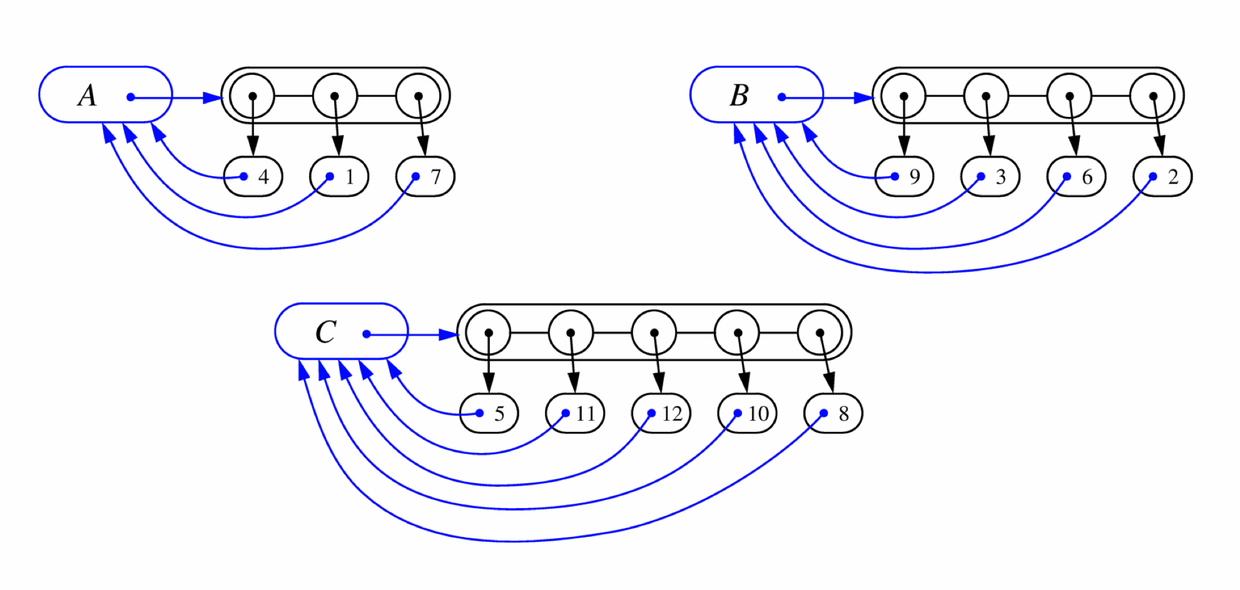
List-based Partition (1)
Each set is stored in a sequence (e.g., list)
Partition: A collection of sequences
Each element has a reference back to the set
Operation find(u): takes O(1) time, and returns the set of which u is a member.
Operation union(A,B): we move the elements of the smaller set to the sequence of the larger set and update their references
Time for operation union(A,B) is min(|A|, |B|)
Worst-case: O(n) for one union operation

Slide 14
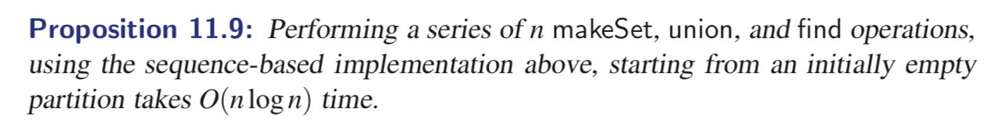
List-based Partition (2)
What about “amortized analysis”? (Page 539)
Clearly, makeSet and find operation → O(n)
Union operation
Each time we move a position from one set to another, the size of the new set at least doubles
Thus, each position is moved from one set to another at most log n times
We assume that the partition is initially empty, there are O(n) different elements referenced in the given series of operations. → The total time for all the union operations is O(n log n)

Slide 15
Partition-Based Implementation
Partition-based version of Kruskal’s Algorithm
Cluster merges as unions
Cluster locations as finds
Running time O((n + m) log n)
PQ operations O(m log n)
PQ initialization: O(mlog m)
For each while loop
O(log m) = O(log n)
UF operations O(n log n)
Algorithm KruskalMST(G)
Initialize a partition P
for each vertex v in G do
P.makeSet(v)
let Q be a priority queue.
Insert all edges into Q
T ← ∅
{T is the union of the MSTs of the clusters}
while T has fewer than n − 1 edges do
e ← Q.removeMin().getValue()
[u, v] ← G.endVertices(e)
A ← P.find(u)
B ← P.find(v)
if A ≠ B then
Add edge e to T
P.union(A, B)
return T

Slide 16
Prim-Janik’s Algorithm

Slide 17
Example
∞
7
2
7
D
2
7
D
B
4
B
4
8
9
∞
5
9
∞
2
5
F
2
5
F
C
8
C
8
8
3
8
3
E
E
A
7
7
A
7
7
0
0
7
7
2
7
D
7
D
B
4
2
B
4
5
9
∞
9
4
2
5
F
5
5
C
2
F
8
C
8
8
3
3
E
8
A
7
E
0
7
A
7
7
0

Slide 18
Example (contd.)
7
2
7
D
B
4
5
9
4
2
5
F
C
8
8
3
E
A
7
3
7
0
7
D
2
B
4
5
9
4
2
5
F
C
8
8
3
E
A
7
3
0

Slide 19
Prim-Jarnik’s Algorithm
Similar to Dijkstra’s algorithm
We pick an arbitrary vertex s and we grow the MST as a cloud of vertices, starting from s
We store with each vertex v label d(v) representing the smallest weight of an edge connecting v to a vertex in the cloud
(see the difference from Dijkstra’s algorithm?)
At each step:
We add to the cloud the vertex u outside the cloud with the smallest distance label
We update the labels of the vertices adjacent to u

Slide 20
Prim-Jarnik’s Algorithm (cont.)
A heap-based adaptable priority queue with location-aware entries stores the vertices outside the cloud
Key: distance
Value: vertex
Recall that method replaceKey(l,k) changes the key of entry l
We store three labels with each vertex:
Distance
Parent edge in MST
Entry in priority queue
Algorithm PrimJarnikMST(G)
Q ← new heap-based priority queue
s ← a vertex of G
for all v ∈ G.vertices()
if v = s
v.setDistance(0)
else
v.setDistance(∞)
v.setParent(∅)
l ← Q.insert(v.getDistance(), v)
v.setLocator(l)
while ¬Q.empty()
l ← Q.removeMin()
u ← l.getValue()
for all e ∈ u.incidentEdges()
z ← e.opposite(u)
r ← e.weight()
if r < z.getDistance()
z.setDistance(r)
z.setParent(e) Q.replaceKey(z.getEntry(), r)

Slide 21
Analysis
Graph operations
Method incidentEdges is called once for each vertex
Label operations
We set/get the distance, parent and locator labels of vertex z O(deg(z)) times
Setting/getting a label takes O(1) time
Priority queue operations
Each vertex is inserted once into and removed once from the priority queue, where each insertion or removal takes O(log n) time (total n O(log n))
The key of a vertex w in the priority queue is modified at most deg(w) times, where each key change takes O(log n) time
Prim-Jarnik’s algorithm runs in O((n + m) log n) time provided the graph is represented by the adjacency list structure
Recall that Σ_{v} deg(v) = 2m
The running time is O(m log n) since the graph is connected

